Slide 1

PHP
Cookies
@ Md. Mizanur Rahman

Slide 2

What is Cookies
Cookies are text files with small pieces of data — like a username and password — that are used to identify your computer as you use a computer network. Specific cookies known as HTTP cookies are used to identify specific users and improve your web browsing experience.
When the cookie is exchanged between your computer and the network server, the server reads the ID and knows what information to specifically serve to you.
01

Slide 3
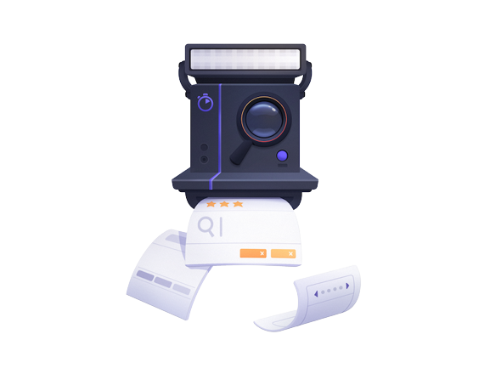
HTTP Cookies
HTTP cookies, or internet cookies, are built specifically for Internet web browsers to track, personalize, and save information about each user’s session.
Cookies are created to identify you when you visit a new website. The web server — which stores the website’s data — sends a short stream of identifying info to your web browser.
Browser cookies are identified and read by name-value pairs. These tell cookies where to be sent and what data to recall.
02

Slide 4

What are cookies used for
Without cookies, you’d have to login again after you leave a site or rebuild your shopping cart if you accidentally close the page
Here’s how cookie are intended to be used:
Session management
Personalization
Tracking
03

Slide 5

Why cookies can be dangerous
Since the data in cookies doesn't change, cookies themselves aren't harmful. They can't infect computers with viruses or other malware.
The danger lies in their ability to track individuals' browsing histories.
04

Slide 6
Create cookie
A cookie is created with setcookie() function
setcookie(name, value, expire, path, domain, secure, httponly);
💡Note – Only the name parameter is required others are optional.
05

Slide 7
Create cookie with PHP
Here we create a cookie named "user" with the value “Abdullah“. So lets prepare a cookie and set it.
<?php $cookie_name = "user"; $cookie_value = “Abdullah"; setcookie($cookie_name, $cookie_value, time() + (3600), "/"); ?>
06

Slide 8
Show the cookie
Show cookie in browser.
<?php if(!isset($_COOKIE[$cookie_name])) { echo "Cookie named '" . $cookie_name . "' is not set!"; }
else { echo "Cookie '" . $cookie_name . "' is set!<br>"; echo "Value is: " . $_COOKIE[$cookie_name]; } ?>
07

Slide 9
Delete the cookie
To delete the cookie we can invoke this.
<?php // set the expiration date to one hour ago setcookie("user", "", time() - 3600); ?>
07

Slide 10
THIS IS IT
THANK YOU

